Slide 1


Astro
Park smart
The Jetsons: Yaswanth, SHUBHAM, PRIYANKA, CK

Slide 2
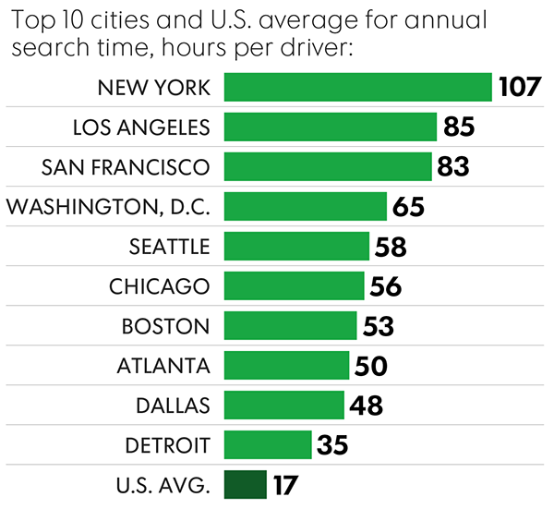
Current Scenario
Time and fuel wastage
Motorists spend an average of 17 hours a year searching for spots
Inefficient use of parking spaces
Around a third of parking spaces in metropolitan areas are always empty

Slide 3
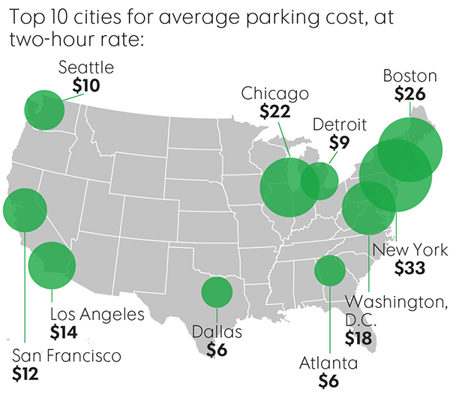
Current Scenario
Overpaying
Parking tickets cost Americans more than $20 billion a year or $97 per driver
Plan cancellations
Nearly 42% of the U.S. respondents said they missed an appointment
34% abandoned a trip because of parking issues

Slide 4

Astro Knows where to take Elroy!
The Jetsons trust Astro because
It makes parking easy
It reserves a spot for you
It can provide useful insights
It can save you from that parking ticket

Slide 5
Follow Astro!
Step 1
Get Astro
Step 2
Search for a parking area around your destination
Step 3
Browse through and select an available parking slot
Step 4
Reserve the slot you want
Step 5
Reach your spot and unlock
Step 6
Park your car

Slide 6

Park Smart with Astro

Slide 7
Park Smart with Astro
:3000
Web Server
:8080
CSE
P1
P1
OM2M
P1
P1
Node MCU
Node MCU
Node MCU
Node MCU
LDR
Motor
LCD

Slide 8
State Machine Diagram
Reserve Spot
A: Yes
R: No
U: NA
A=Yes
R=Yes
U=No
Occupied
A-Spot Available
R- Reserve Spot
U- Unlock Spot (If reserved)
Available
Vehicle Left
Unlock
A: No
R: No
U: NA
Parked
A=Yes
R=Yes
U=Yes
A: No
R: Yes
U: Yes

Slide 9

Issues Astro is helping us with
Relax and know your spot before, you get there
Don’t worry about forgetting allotted time, Astro will remind you!
Save time in finding a parking spot

Slide 10
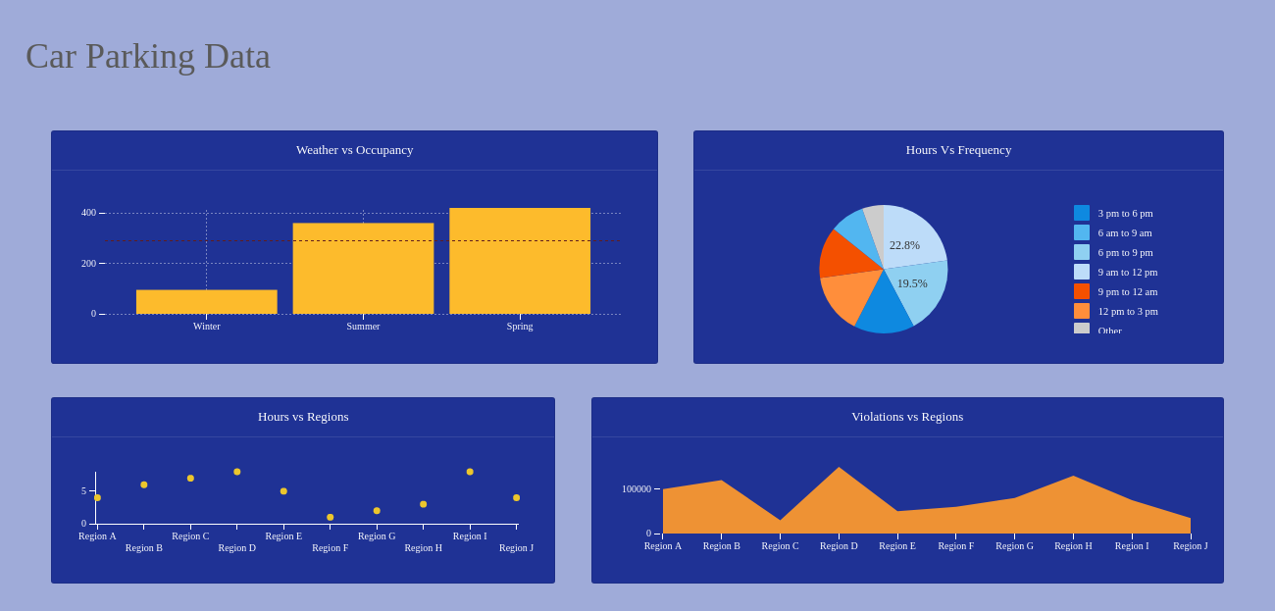
Issues Astro can help us with
Plan better for parking places, better utilization of space available with the data collected
Analyze parking patterns over a period of time over specific regions
Predict the parking availability using historical data

Slide 11
What Astro is made of
Light sensor to determine if a parking spot is available
LED and LCD to indicate availability status
Servo motor to lock and unlock the parking spot
NodeMCU to send sensor data to CSE
Arduino UNO to provide 5 volts to power LCD and servo motor

Slide 12
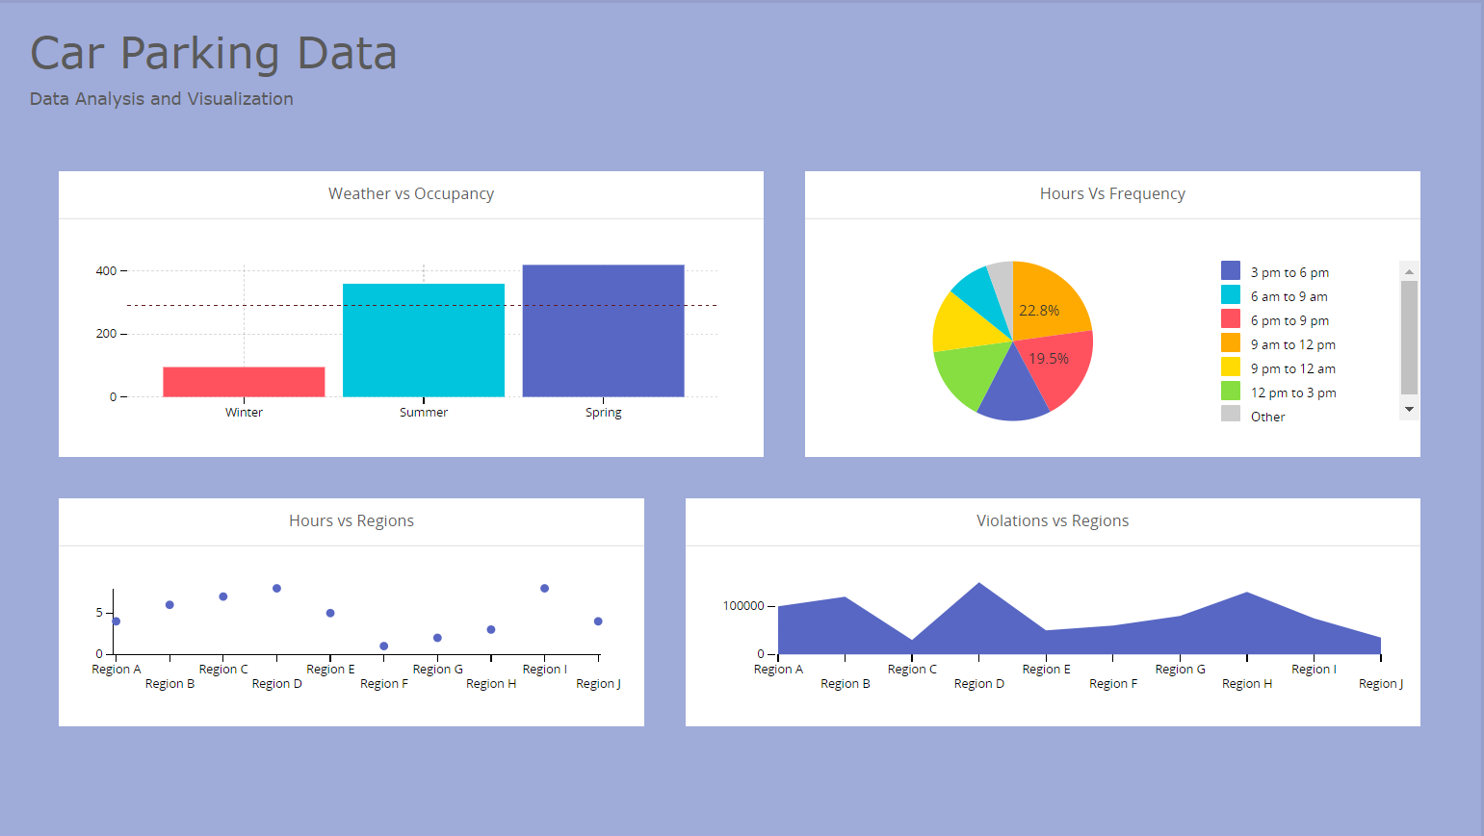
Dashboard
Preview

Slide 13
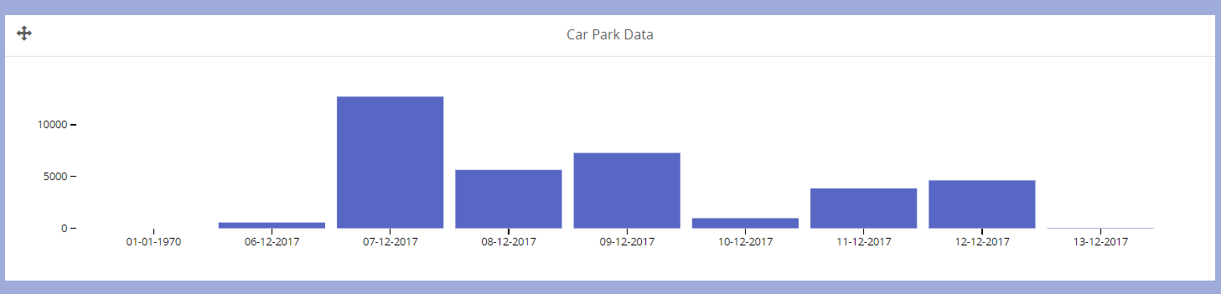
Occupancy trends from Car Park Data
Preview

Slide 14
Data Insights
Analyzing occupancy trends with respect to weather
Dynamic Pricing – Price of parking tickets can be decided based on demand
Use the duration and frequency of visits of users to provide better customer service
Intuitive level heatmaps showing the most heavily utilized parking spots

Slide 15
Data Insights
Data can be used by developers tor better parking space allocation
Using GPS, we could see how parking trends change when shopping centers, retail stores and restaurants are nearby
Historical data can be used to predict parking spot availability at some time during a day, or during certain weather conditions

Slide 16
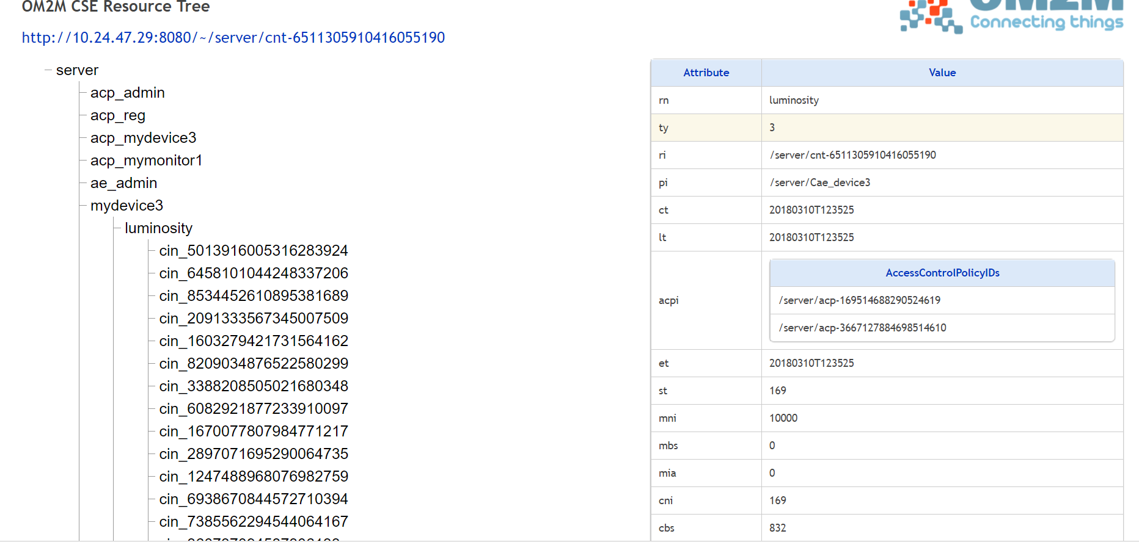
Back up Slides!
Resource Tree

